Slide 1
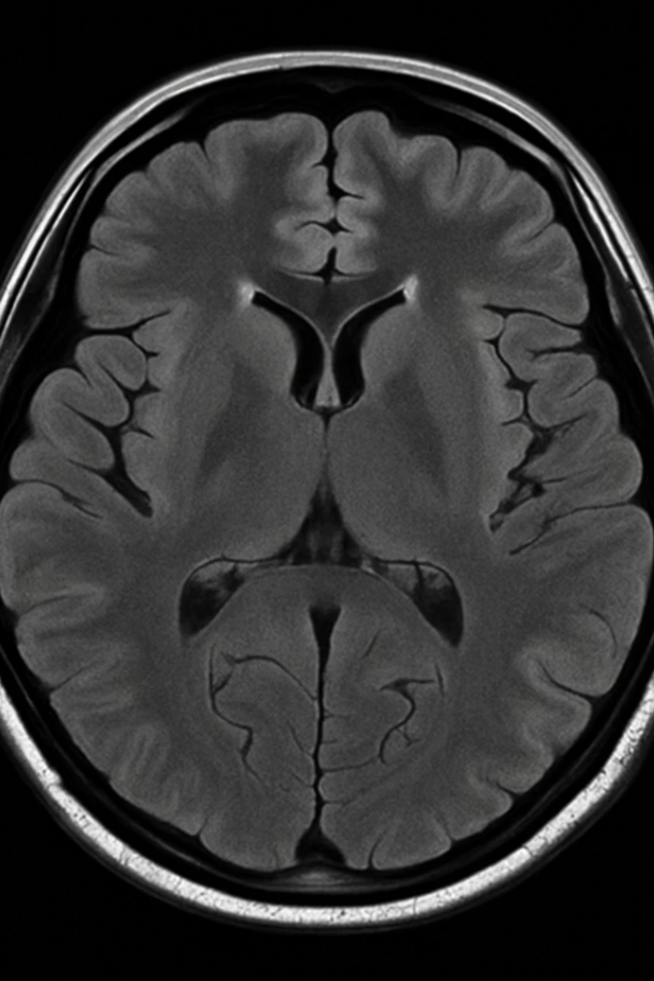
Please measure the brain's bone-to-bone diameter

Slide 2
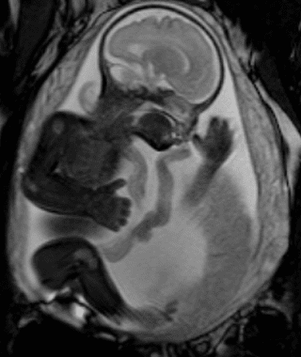
Why get MRI?
Please measure the brain's bone-to-bone diameter
For the fetus: Clarifying unclear ultrasound, findings brain abnormalities, etc.
For the mother: Appendicitis, cancer evaluation, neurological symptoms etc.

Slide 3
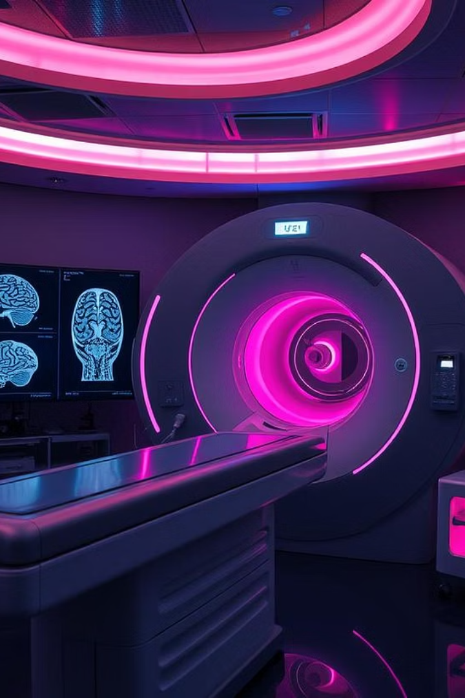
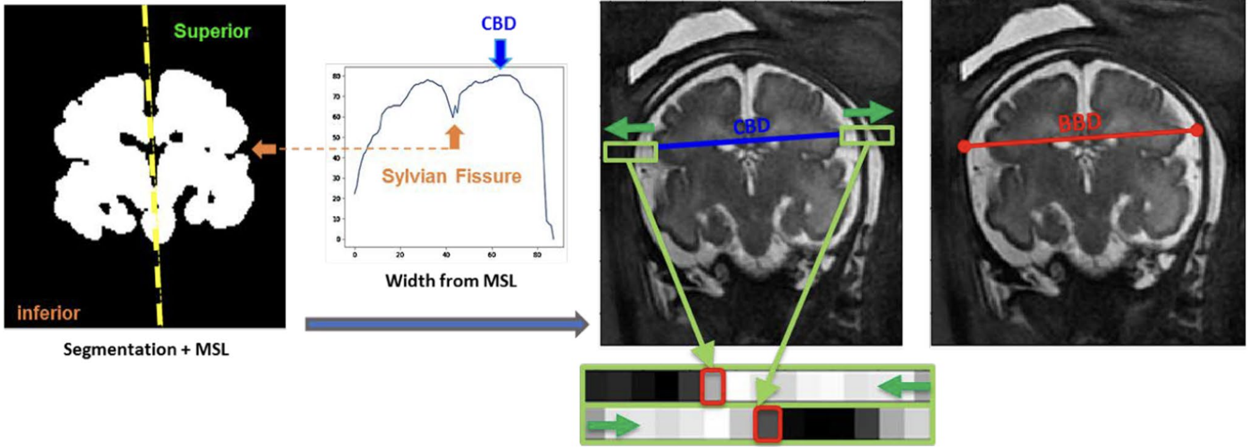
Automated Fetal Brain Measurement from MRI
Jonathan Lautman, Naveh Ayal, & Itamar Cohen
Real-Time Analysis Goal : Aims for immediate, automated analysis during clinical MRI scans.

Slide 4
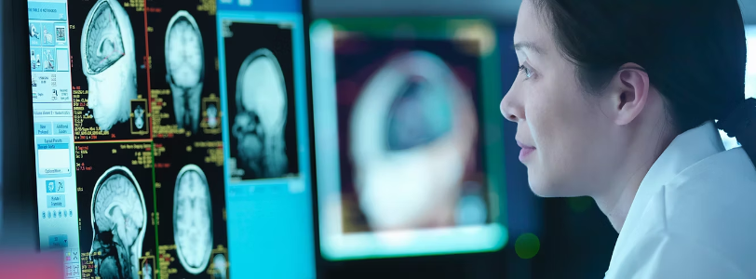






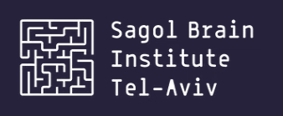
Error uploading image.
Advanced Brain Imaging Lab
Lead by Professor Dafna Ben-Bashat
Subjectivity into Automative
"Just" MRI scans into data-rich outputs
Enabling tasks physicians can perform manually
Automating tasks physicians can’t reliably perform
Reducing variability and minimizing human error in fetal brain evaluation
Not just “cerebral hemispheres appear small” — but exact dimensions, angles, and volumes
Segmentation of brain structure
Objective evaluation of sulcation and subtle developmental patterns

Slide 5
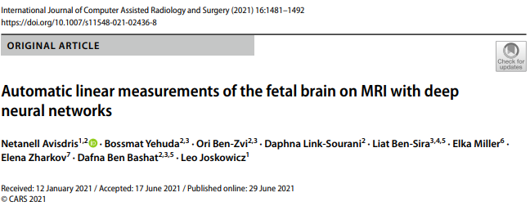

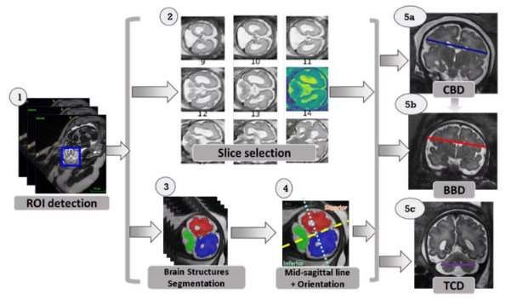




Solution Pipeline:
1. Fetal Brain Localization
Identification of fetal brain regions from MRI scan (Blue box)
2. Reference Slice Selection
Choosing the optimal slices for each measurement
3. Structure Segmentation
Segmentation of fetal brain to 2 hemispheres & Cerebellum
4. Mid-Sagittal Line and Orientation Computation
Ensuring accurate and consistent reference points.
5. Measurement Computation
Geometric algorithms extract diameters (CBD, BBD, TCD)
*BBD - bone biparietal diameter , CBD - cerebral biparietal diameter) TCD - transcerebellum diameter
Notes:
Blue Box - ROI (Region Of Interest)
Slice selection
Segmentation: cerebellum (green), left (blue) and right (red) hemispheres
MSL (yellow line) and brain orientation (separated by light blue line) computation
CBD (cerebral biparietal diameter), BBD (bone biparietal diameter), and TCD (trans-cerebellar diameter) measurements

Slide 7
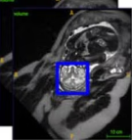
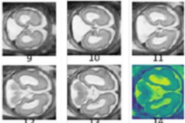
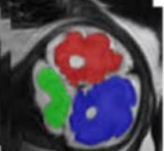
Neural Networks (1-3)
Stage
Neural Network Type
Training Data
Accuracy Rate
1. ROI Detection
Anisotropic 3D U-Net classifier
Trained on 6 annotated MRI volumes, validated on 29 volumes
100% ROI detection rate
2. Reference Slice Selection
CNN Classifier – Modified version of ResNet50, pre-trained on ImageNet
49 volumes for training ,
43 for validation for both the CBD/BBD and the TCD slice selection networks
All networks tested achieved a mean difference of < 1 slice
3. Brain Structure Segmentation
2D U-Net consisting of a Resnet34 encoder pre-trained on the ImageNet dataset
1008 slices were used for training and 100 for testing
Accurate and reliable Scores:
Right Hemisphere - 0.945
Left Hemisphere - 0.946
Cerebellum - 0.851
*The MSL and Orientation Computation and the Linear CBD, BBD and TCD measurements computation stages does not use a neural network. Instead, it uses a classical image processing and geometry-based approach.
Notes:
1. Anisotropic 3D U-Net for Brain ROI Detection
What is it?
A variant of the standard U-Net architecture, designed for 3D medical images.
“Anisotropic” means it uses different resolutions or kernel sizes in different spatial directions, which is ideal for MRI scans that may have higher in-plane resolution but thicker slices.
How does it work?
The network receives a downsampled version of the full MRI scan as input.
It outputs a probability map highlighting the location of the fetal brain within the larger abdominal scan.
From this, a tight 3D bounding box (“region of interest,” ROI) is extracted to focus all subsequent processing on the brain only.
Why is it used here?
It quickly and accurately identifies the brain region with minimal training data (100% detection rate with just a handful of annotated volumes).
Reduces the amount of data to process, and helps downstream models focus only on the relevant anatomy.
2. Reference Slice Selection: CNN Classifier (ResNet50 Variant)
What is it?
A Convolutional Neural Network classifier, based on the ResNet50 architecture (a deep residual network widely used in image recognition).
Pre-trained on ImageNet for robust feature extraction, then fine-tuned for the specific task of selecting key MRI slices.
How does it work?
For each MRI scan, the model predicts the probability of each slice being the “reference slice” required for measurement (CBD/BBD or TCD).
It is trained as a binary classifier—each slice is labeled as reference or not.
Data augmentations (cropping, rotation, flips) are used during training for better generalization.
Why is it used here?
Automates what radiologists do: selecting the optimal anatomical plane for accurate measurement.
Consistently chooses the correct slice (mean error less than one slice) even across varying brain orientations and scan protocols.
3. Brain Structure Segmentation: 2D U-Net with ResNet34 Encoder
What is it?
A classic U-Net architecture for 2D image segmentation, with the encoder (downsampling path) replaced by ResNet34 for enhanced feature extraction.
The encoder is pre-trained on ImageNet, which helps the network generalize better from limited medical data.
How does it work?
Operates on the selected reference slices, segmenting each into regions: left hemisphere, right hemisphere, cerebellum, and background.
Outputs pixel-wise labels for each anatomical structure, enabling precise localization for subsequent measurements.
Why is it used here?
U-Net is a gold standard for medical image segmentation, especially when annotated data is limited.
Adding a ResNet34 encoder improves learning of complex features.
Dice scores above 0.94 for hemispheres demonstrate near-expert-level segmentation quality, supporting reliable measurement extraction.
General Notes (For All Stages)
All models use transfer learning from large public datasets (like ImageNet) to compensate for the relatively small size of annotated fetal MRI datasets.
Post-processing and reliability checks are integrated into the pipeline to ensure only trustworthy results are provided to clinicians.
This approach (using pre-trained, state-of-the-art networks with data augmentation and validation) follows current best practices in medical imaging AI.

Slide 8
ROI Detection - Anisotropic 3D U-Net classifier
What is it?
A variant of the standard U-Net architecture, designed for 3D medical images.
“Anisotropic” means it uses different resolutions or kernel sizes in different spatial directions, which is ideal for MRI scans that may have higher in-plane resolution but thicker slices.
How does it work?
The network receives a downsampled version of the full MRI scan as input.
It outputs a probability map highlighting the location of the fetal brain within the larger abdominal scan.
From this, a tight 3D bounding box (“region of interest,” ROI) is extracted to focus all subsequent processing on the brain only.
Why is it used here?
It quickly and accurately identifies the brain region with minimal training data (100% detection rate with just a handful of annotated volumes).
Reduces the amount of data to process, and helps downstream models focus only on the relevant anatomy.
Notes:
1. Anisotropic 3D U-Net for Brain ROI Detection
What is it?
A variant of the standard U-Net architecture, designed for 3D medical images.
“Anisotropic” means it uses different resolutions or kernel sizes in different spatial directions, which is ideal for MRI scans that may have higher in-plane resolution but thicker slices.
How does it work?
The network receives a downsampled version of the full MRI scan as input.
It outputs a probability map highlighting the location of the fetal brain within the larger abdominal scan.
From this, a tight 3D bounding box (“region of interest,” ROI) is extracted to focus all subsequent processing on the brain only.
Why is it used here?
It quickly and accurately identifies the brain region with minimal training data (100% detection rate with just a handful of annotated volumes).
Reduces the amount of data to process, and helps downstream models focus only on the relevant anatomy.
2. Reference Slice Selection: CNN Classifier (ResNet50 Variant)
What is it?
A Convolutional Neural Network classifier, based on the ResNet50 architecture (a deep residual network widely used in image recognition).
Pre-trained on ImageNet for robust feature extraction, then fine-tuned for the specific task of selecting key MRI slices.
How does it work?
For each MRI scan, the model predicts the probability of each slice being the “reference slice” required for measurement (CBD/BBD or TCD).
It is trained as a binary classifier—each slice is labeled as reference or not.
Data augmentations (cropping, rotation, flips) are used during training for better generalization.
Why is it used here?
Automates what radiologists do: selecting the optimal anatomical plane for accurate measurement.
Consistently chooses the correct slice (mean error less than one slice) even across varying brain orientations and scan protocols.
3. Brain Structure Segmentation: 2D U-Net with ResNet34 Encoder
What is it?
A classic U-Net architecture for 2D image segmentation, with the encoder (downsampling path) replaced by ResNet34 for enhanced feature extraction.
The encoder is pre-trained on ImageNet, which helps the network generalize better from limited medical data.
How does it work?
Operates on the selected reference slices, segmenting each into regions: left hemisphere, right hemisphere, cerebellum, and background.
Outputs pixel-wise labels for each anatomical structure, enabling precise localization for subsequent measurements.
Why is it used here?
U-Net is a gold standard for medical image segmentation, especially when annotated data is limited.
Adding a ResNet34 encoder improves learning of complex features.
Dice scores above 0.94 for hemispheres demonstrate near-expert-level segmentation quality, supporting reliable measurement extraction.
General Notes (For All Stages)
All models use transfer learning from large public datasets (like ImageNet) to compensate for the relatively small size of annotated fetal MRI datasets.
Post-processing and reliability checks are integrated into the pipeline to ensure only trustworthy results are provided to clinicians.
This approach (using pre-trained, state-of-the-art networks with data augmentation and validation) follows current best practices in medical imaging AI.

Slide 9
Slice Selection - Modified ResNet50, pre-trained ImageNet
What is it?
A Convolutional Neural Network classifier, based on the ResNet50 architecture (a deep residual network widely used in image recognition).
Pre-trained on ImageNet for robust feature extraction, then fine-tuned for the specific task of selecting key MRI slices.
How does it work?
For each MRI scan, the model predicts the probability of each slice being the “reference slice” required for measurement (CBD/BBD or TCD).It is trained as a binary classifier—each slice is labeled as reference or not.
Data augmentations (cropping, rotation, flips) are used during training for better generalization.
Why is it used here?
Automates what radiologists do: selecting the optimal anatomical plane for accurate measurement.
Consistently chooses the correct slice (mean error less than one slice) even across varying brain orientations and scan protocols.
Notes:
1. Anisotropic 3D U-Net for Brain ROI Detection
What is it?
A variant of the standard U-Net architecture, designed for 3D medical images.
“Anisotropic” means it uses different resolutions or kernel sizes in different spatial directions, which is ideal for MRI scans that may have higher in-plane resolution but thicker slices.
How does it work?
The network receives a downsampled version of the full MRI scan as input.
It outputs a probability map highlighting the location of the fetal brain within the larger abdominal scan.
From this, a tight 3D bounding box (“region of interest,” ROI) is extracted to focus all subsequent processing on the brain only.
Why is it used here?
It quickly and accurately identifies the brain region with minimal training data (100% detection rate with just a handful of annotated volumes).
Reduces the amount of data to process, and helps downstream models focus only on the relevant anatomy.
2. Reference Slice Selection: CNN Classifier (ResNet50 Variant)
What is it?
A Convolutional Neural Network classifier, based on the ResNet50 architecture (a deep residual network widely used in image recognition).
Pre-trained on ImageNet for robust feature extraction, then fine-tuned for the specific task of selecting key MRI slices.
How does it work?
For each MRI scan, the model predicts the probability of each slice being the “reference slice” required for measurement (CBD/BBD or TCD).
It is trained as a binary classifier—each slice is labeled as reference or not.
Data augmentations (cropping, rotation, flips) are used during training for better generalization.
Why is it used here?
Automates what radiologists do: selecting the optimal anatomical plane for accurate measurement.
Consistently chooses the correct slice (mean error less than one slice) even across varying brain orientations and scan protocols.
3. Brain Structure Segmentation: 2D U-Net with ResNet34 Encoder
What is it?
A classic U-Net architecture for 2D image segmentation, with the encoder (downsampling path) replaced by ResNet34 for enhanced feature extraction.
The encoder is pre-trained on ImageNet, which helps the network generalize better from limited medical data.
How does it work?
Operates on the selected reference slices, segmenting each into regions: left hemisphere, right hemisphere, cerebellum, and background.
Outputs pixel-wise labels for each anatomical structure, enabling precise localization for subsequent measurements.
Why is it used here?
U-Net is a gold standard for medical image segmentation, especially when annotated data is limited.
Adding a ResNet34 encoder improves learning of complex features.
Dice scores above 0.94 for hemispheres demonstrate near-expert-level segmentation quality, supporting reliable measurement extraction.
General Notes (For All Stages)
All models use transfer learning from large public datasets (like ImageNet) to compensate for the relatively small size of annotated fetal MRI datasets.
Post-processing and reliability checks are integrated into the pipeline to ensure only trustworthy results are provided to clinicians.
This approach (using pre-trained, state-of-the-art networks with data augmentation and validation) follows current best practices in medical imaging AI.

Slide 10
Structure Segmentation - 2D U-Net with ResNet34 Encoder
What is it?
A classic U-Net architecture for 2D image segmentation, with the encoder (downsampling path) replaced by ResNet34 for enhanced feature extraction.
The encoder is pre-trained on ImageNet, which helps the network generalize better from limited medical data.
How does it work?
Operates on the selected reference slices, segmenting each into regions: left hemisphere, right hemisphere, cerebellum, and background.
Outputs pixel-wise labels for each anatomical structure, enabling precise localization for subsequent measurements.
Why is it used here?
U-Net is a gold standard for medical image segmentation, especially when annotated data is limited.
Adding a ResNet34 encoder improves learning of complex features.
Dice scores above 0.94 for hemispheres demonstrate near-expert-level segmentation quality, supporting reliable measurement extraction.
Notes:
1. Anisotropic 3D U-Net for Brain ROI Detection
What is it?
A variant of the standard U-Net architecture, designed for 3D medical images.
“Anisotropic” means it uses different resolutions or kernel sizes in different spatial directions, which is ideal for MRI scans that may have higher in-plane resolution but thicker slices.
How does it work?
The network receives a downsampled version of the full MRI scan as input.
It outputs a probability map highlighting the location of the fetal brain within the larger abdominal scan.
From this, a tight 3D bounding box (“region of interest,” ROI) is extracted to focus all subsequent processing on the brain only.
Why is it used here?
It quickly and accurately identifies the brain region with minimal training data (100% detection rate with just a handful of annotated volumes).
Reduces the amount of data to process, and helps downstream models focus only on the relevant anatomy.
2. Reference Slice Selection: CNN Classifier (ResNet50 Variant)
What is it?
A Convolutional Neural Network classifier, based on the ResNet50 architecture (a deep residual network widely used in image recognition).
Pre-trained on ImageNet for robust feature extraction, then fine-tuned for the specific task of selecting key MRI slices.
How does it work?
For each MRI scan, the model predicts the probability of each slice being the “reference slice” required for measurement (CBD/BBD or TCD).
It is trained as a binary classifier—each slice is labeled as reference or not.
Data augmentations (cropping, rotation, flips) are used during training for better generalization.
Why is it used here?
Automates what radiologists do: selecting the optimal anatomical plane for accurate measurement.
Consistently chooses the correct slice (mean error less than one slice) even across varying brain orientations and scan protocols.
3. Brain Structure Segmentation: 2D U-Net with ResNet34 Encoder
What is it?
A classic U-Net architecture for 2D image segmentation, with the encoder (downsampling path) replaced by ResNet34 for enhanced feature extraction.
The encoder is pre-trained on ImageNet, which helps the network generalize better from limited medical data.
How does it work?
Operates on the selected reference slices, segmenting each into regions: left hemisphere, right hemisphere, cerebellum, and background.
Outputs pixel-wise labels for each anatomical structure, enabling precise localization for subsequent measurements.
Why is it used here?
U-Net is a gold standard for medical image segmentation, especially when annotated data is limited.
Adding a ResNet34 encoder improves learning of complex features.
Dice scores above 0.94 for hemispheres demonstrate near-expert-level segmentation quality, supporting reliable measurement extraction.
General Notes (For All Stages)
All models use transfer learning from large public datasets (like ImageNet) to compensate for the relatively small size of annotated fetal MRI datasets.
Post-processing and reliability checks are integrated into the pipeline to ensure only trustworthy results are provided to clinicians.
This approach (using pre-trained, state-of-the-art networks with data augmentation and validation) follows current best practices in medical imaging AI.

Slide 11

Measurement Method
4. Mid-Sagittal Line and Orientation Computation
5. Measurement Computation

Slide 12
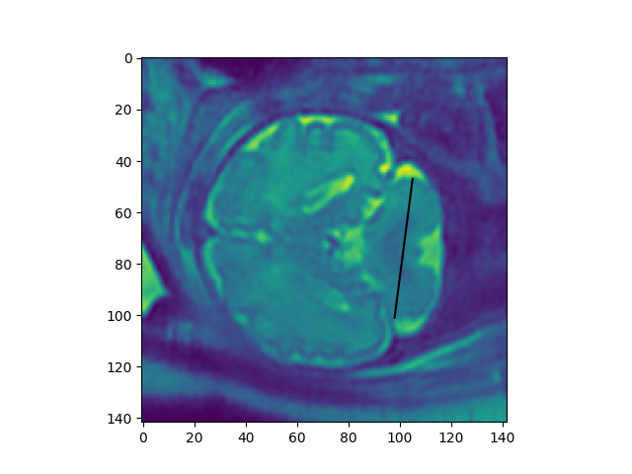
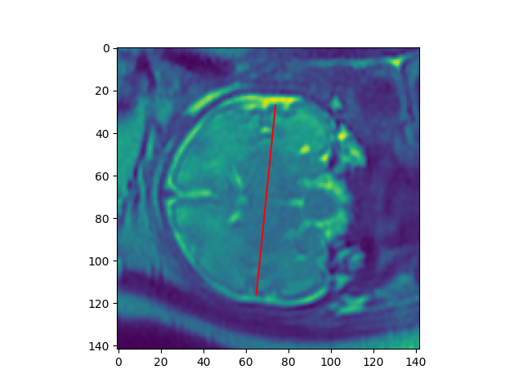
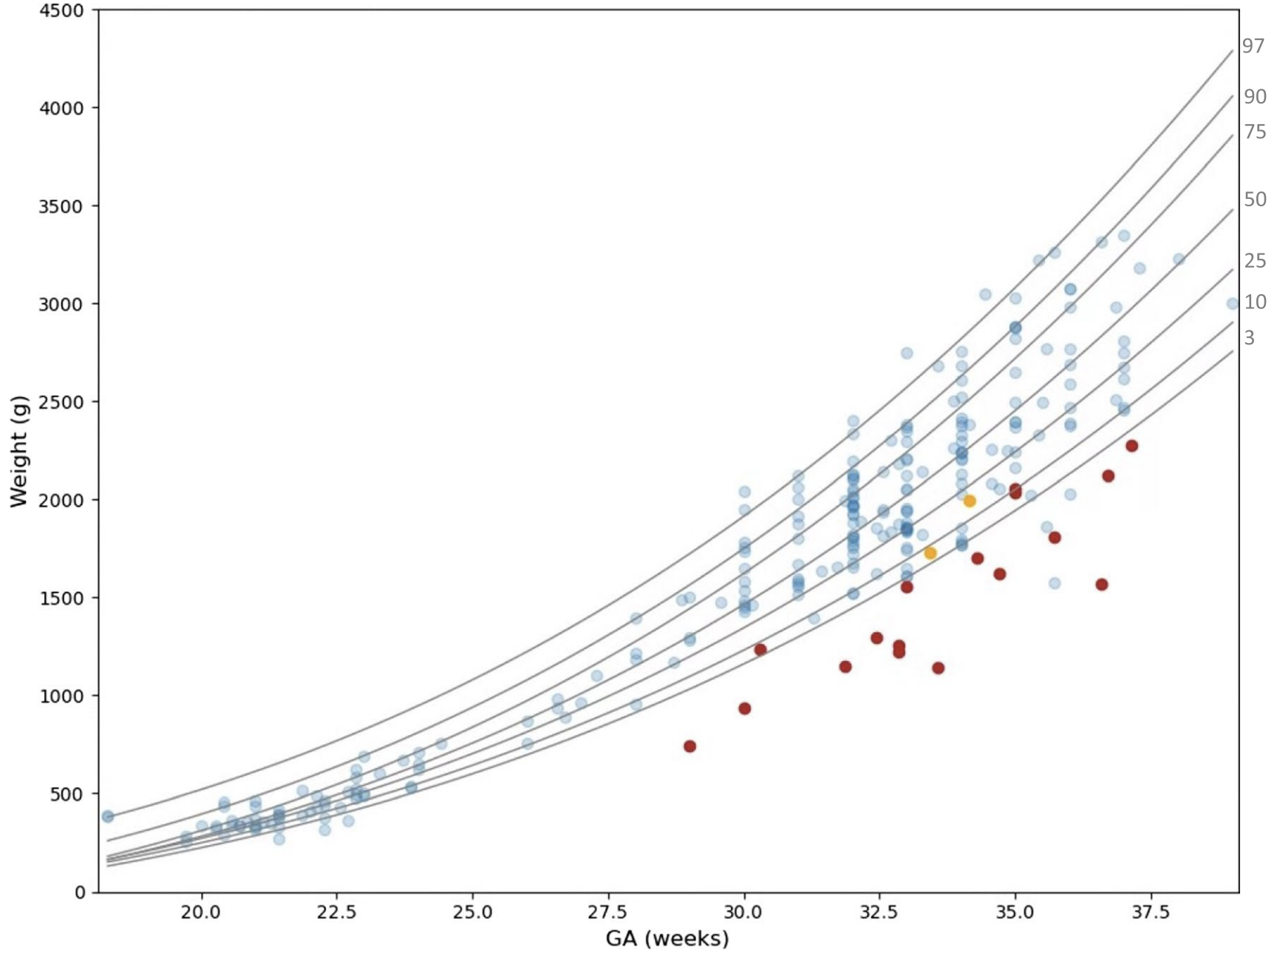

Final Output – Quantitative Report
TCD
CBD
Example (Weight Distirbution) Blue – normal
Orange – mild to moderate abnormality
Red – severe abnormality
BBD
Example
BBD (bone biparietal diameter) – 100 cm
CBD (cerebral biparietal diameter) – 90 cm
TCD (transcerebellum diameter) – 55 cm

Slide 13
Alternative Approach
Using a Deep Learning Landmark Network with Reliability Estimation
1. Fetal Brain Localization
Automatic identification of fetal brain regions from MRI scans
Pros:
More robust
Easily extendable
2. Reference Slice Selection
A neural network-based method for selecting optimal reference MRI slices
3. Landmarks Detection
Cons:
Less Interpretable
Needs more validation to gain trust for medical use
A neural network-based method for detecting two endpoints for each linear measurement in the references slice
4. Measurement Reliability Estimation
Applying test-time augmentation and clustering to estimate the reliability of predicted landmarks
***Prior student project showed lower reliability and precision — further development required
Notes:
This is more robust due to clustering. Our pipeline depends on segmentaion quality.

Slide 14

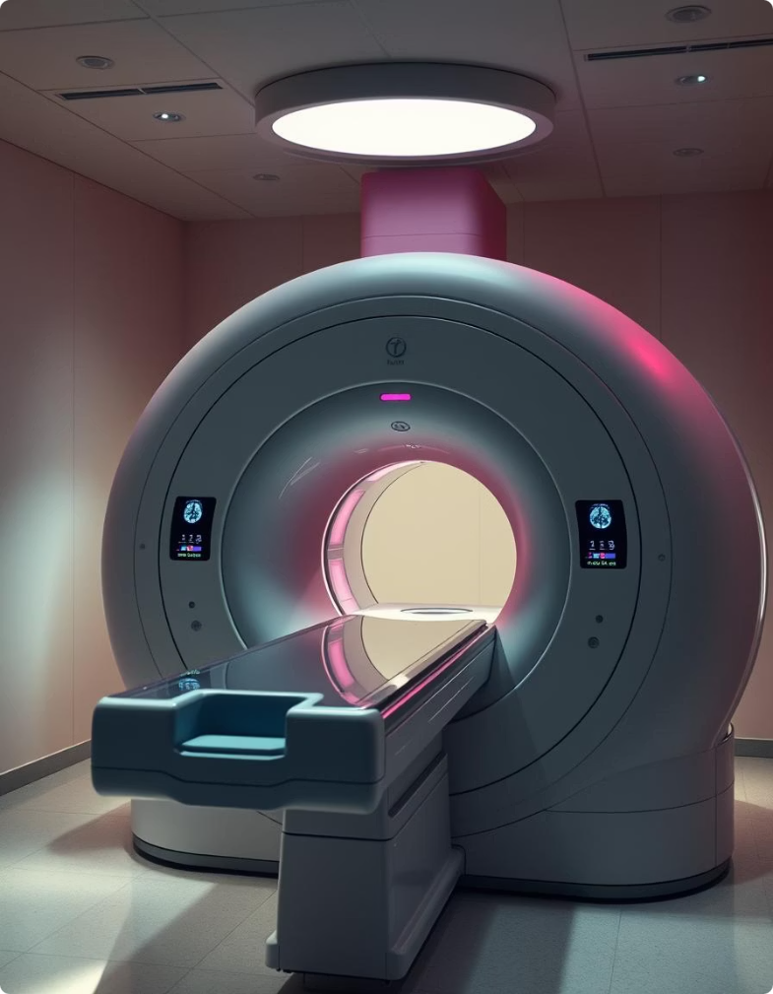


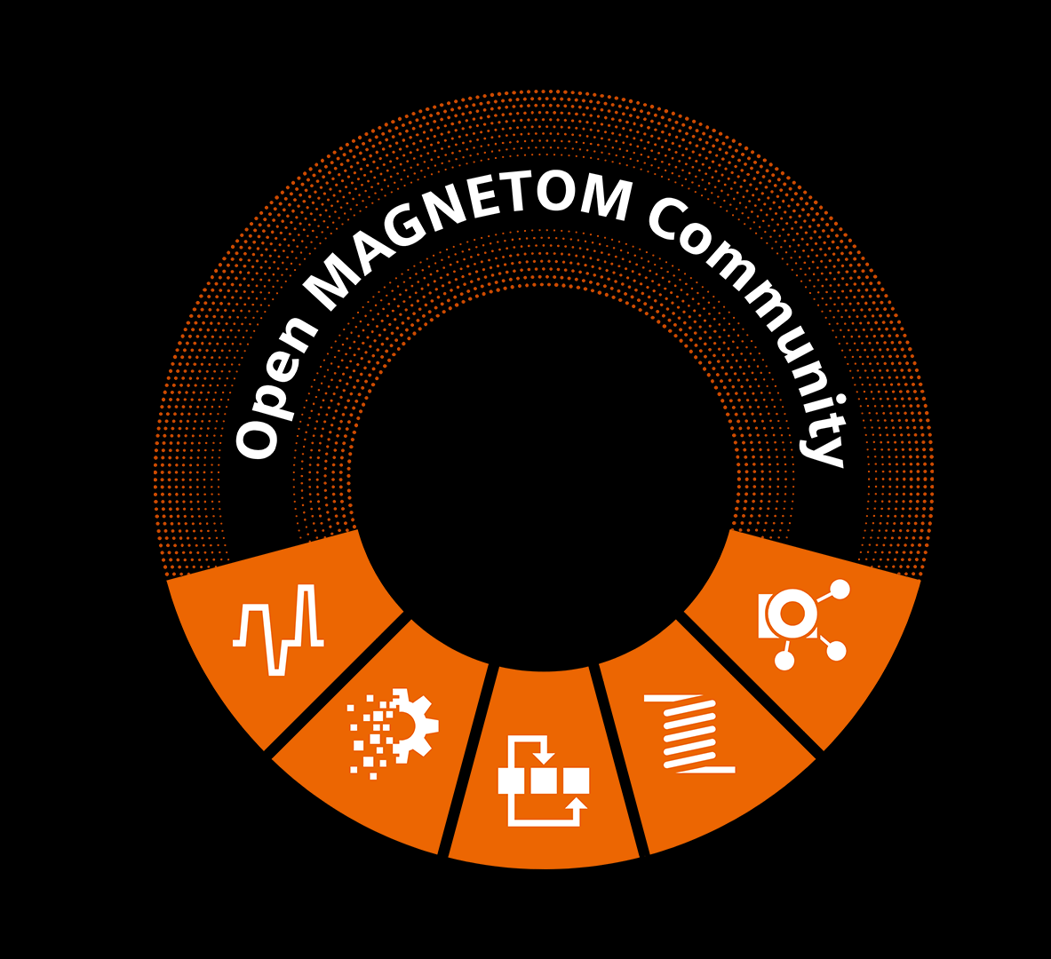
Integrating the Pipeline into Clinical MRI Workflow
Pipeline application is deployed via Docker on SIEMENS
Magnetom Terra MRI machine at Ichilov Hospital.
Siemens OpenRecon provides access to the reconstruction
layer on the MRI system.

Slide 15


Barriers to Deployment:
Models/Docker versions mismatch
Distorted Output
Adapt Model for Newer Frameworks
Find Compatible Environment
Pros: Long-term sustainability and compatibility.
Pros: Minimal modifications, preserves existing model integrity.
Cons: Time-consuming, requires annotated data and revalidation.
Cons: Limited hardware availability; not future-proof.
Integrating the pipeline into SIEMENS Open Recon:
Has not yet been demonstrated in the lab
Specific system protocols and restrictions

Slide 16
Questions?

Slide 17
Commets:
explain about the models used in the pipeline
exalpin when why and how often pregnant women get MRI scans.
consider adding to the model table columns of input and output
Adjust slide 3 visuality V
Add reference for the article V
Another slide about the measuring with relevant pictures of final outputs. Also add the pdf with medical conclusion regarding proper fetal brain development.
Add slide about openrecon
Add slide what we have done so far and what still lies ahead.
Helps for proper development, optional pathologies: macro or micro cephally, extra fluid next to skull, measure only those because of what physicians are used to

Slide 18
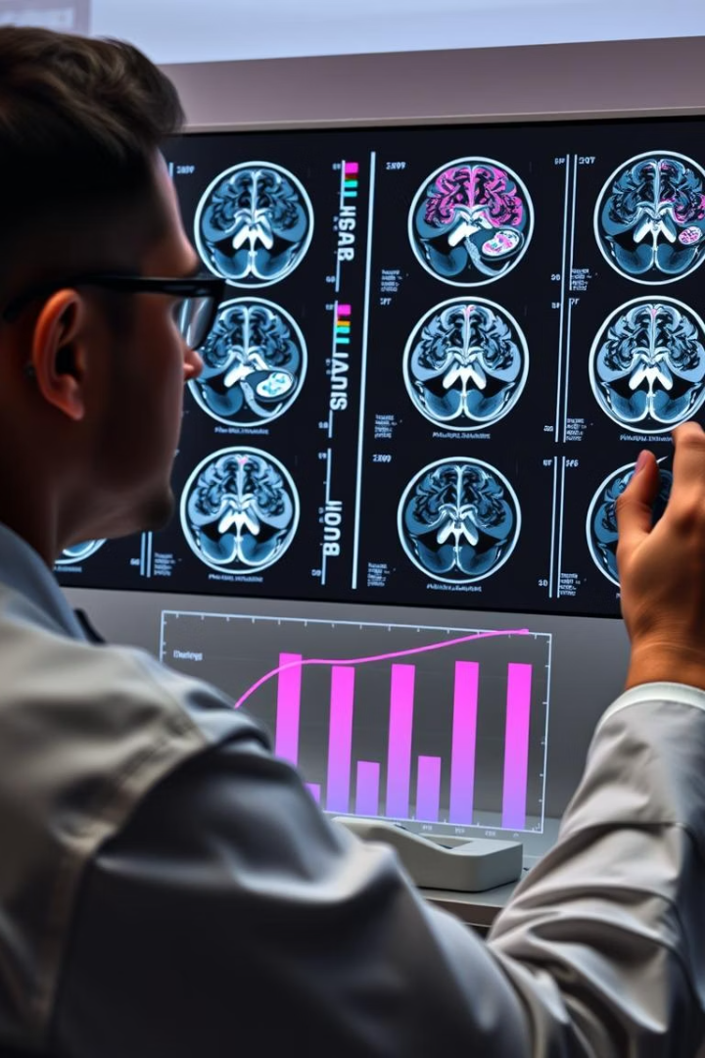
Problem Context and Significance
Accurate assessment of fetal brain development is crucial for detecting abnormalities and guiding clinical decisions in many pregnancies.
Current Challenges
Impacts
Manual MRI measurements: 2 mins/scan
Delays diagnosis and adds anxiety
Subjectivity: 2-4mm variability
Increases healthcare costs
Misdiagnosis risks: growth percentile shifts
Consumes radiologist time
Affects millions globally
No automated MRI solutions exist

Slide 19
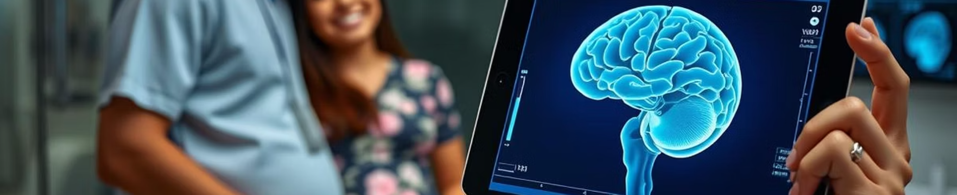



Anticipated Impact and Future Work
Economic Benefits
Clinical Benefits
Social Benefits
Radiologist time saved
Improved accuracy, reduced misdiagnosis
Reduced anxiety, improved pregnancy experience

Slide 20

Error uploading image.
The Sagol Brain Institute: Advanced Brain Imaging Lab Lead by Dafna Ben-Bashat
The Sagol Brain Institute pioneers advanced MRI techniques. We characterize brain tissue and vascular systems. Our goal is to enhance diagnosis and assess therapy response. Key research areas in our project include fetal brain development.

